Slide 1
INTERNSHIP STUDIO INTERNSHIP FOR ETHICAL HACKING TASK-2

Slide 2
STEPS INVOLVED:
Use burpsuit for this method
Open Firefox and set the proxy setting as burpsuit proxy
Turn on intercept in burpsuit
In Firefox open the link http://testasp.vulnweb.com
Forward in intercept in burpsuit
Try the XSS script <script>alert(1)</> in search box
In burpsuit forward the response in intruder

Slide 3
In intruder section, post the XSS scripts and start attack
Check which XSS script that intruded, copy the response of it and paste it in Firefox browser to see how it works
Here <script>alert(1)</script> works and gives out an response of
script injection

Slide 4
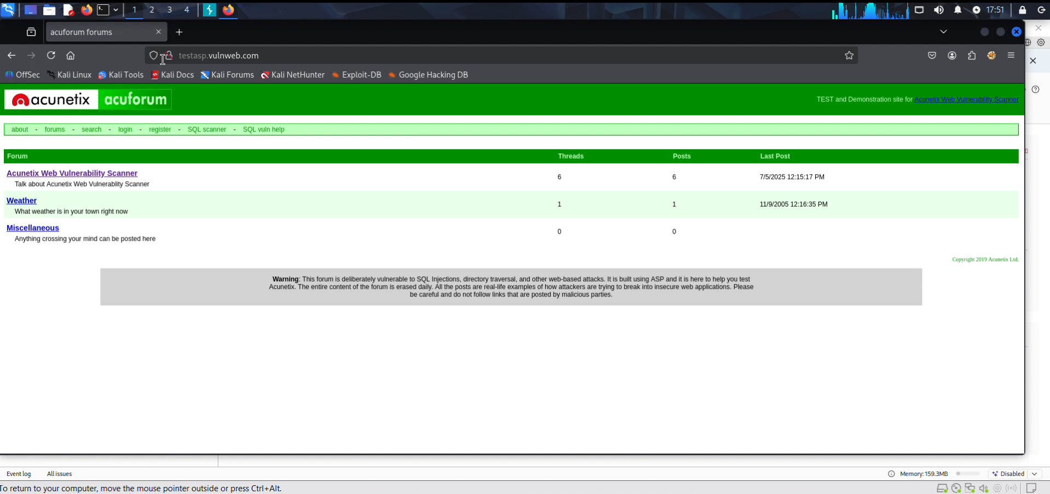

Slide 5
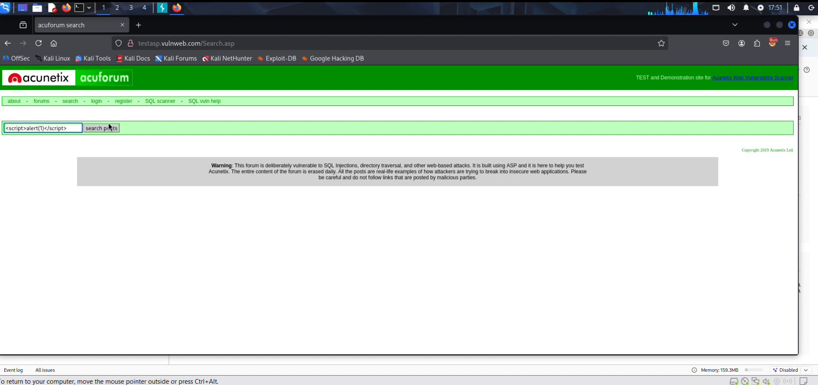

Slide 6
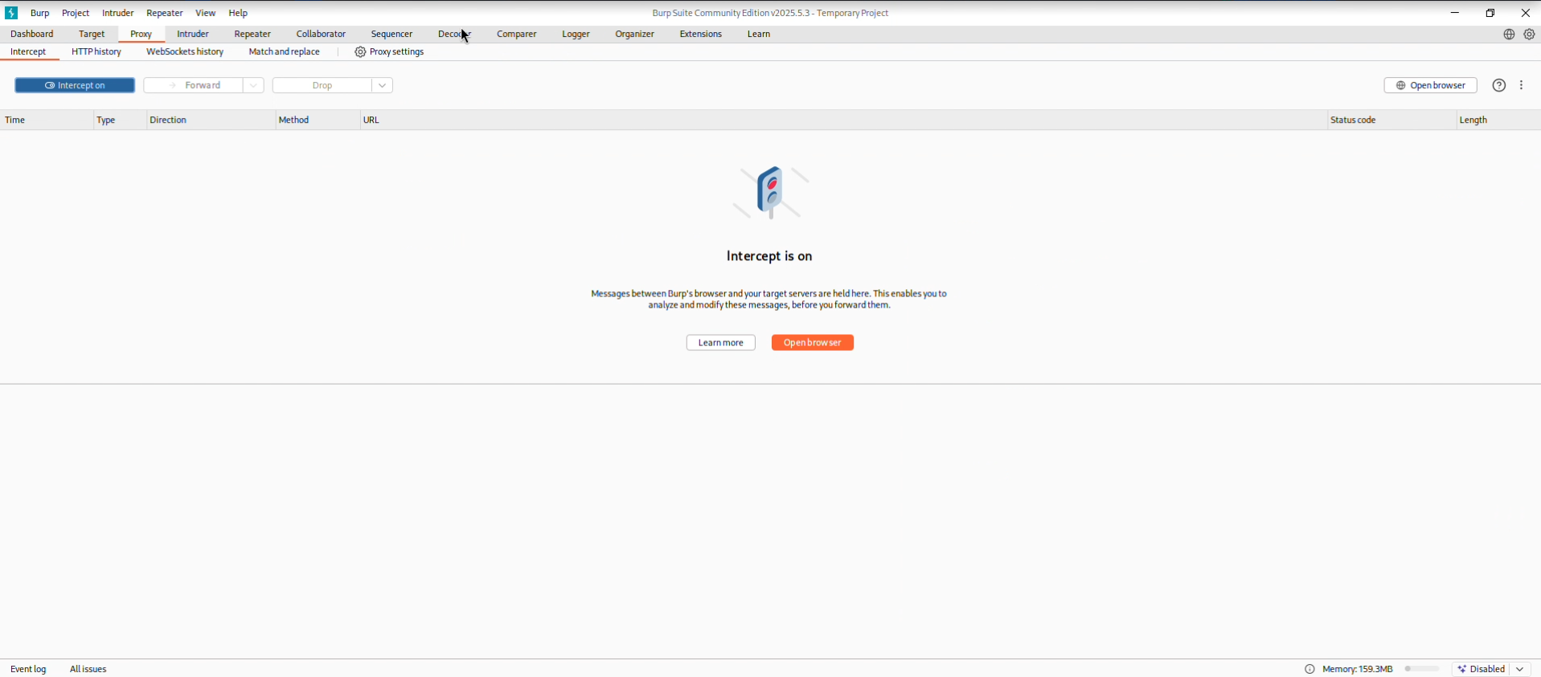

Slide 7
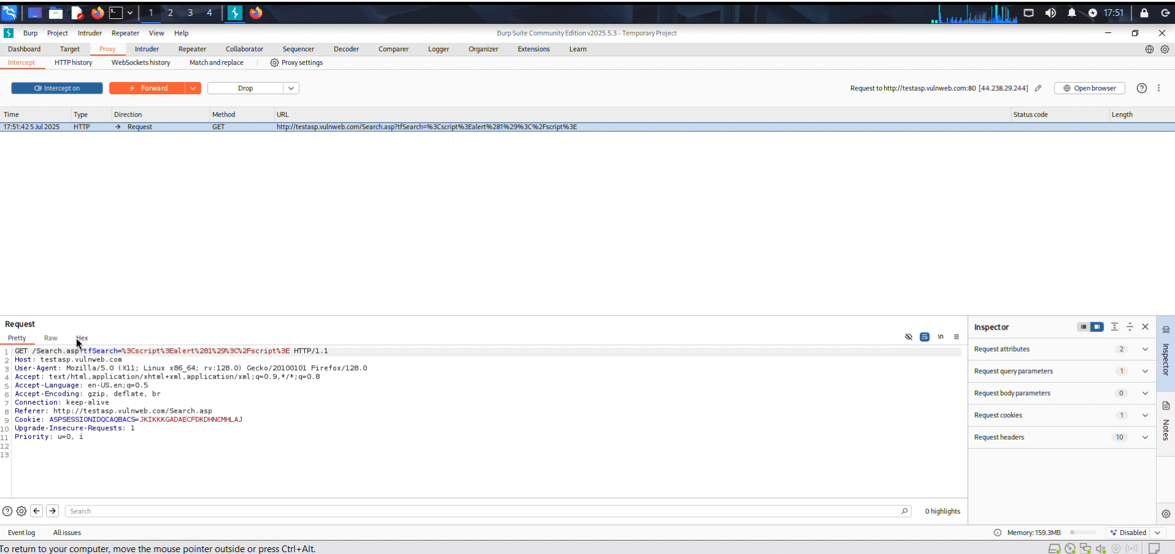

Slide 8
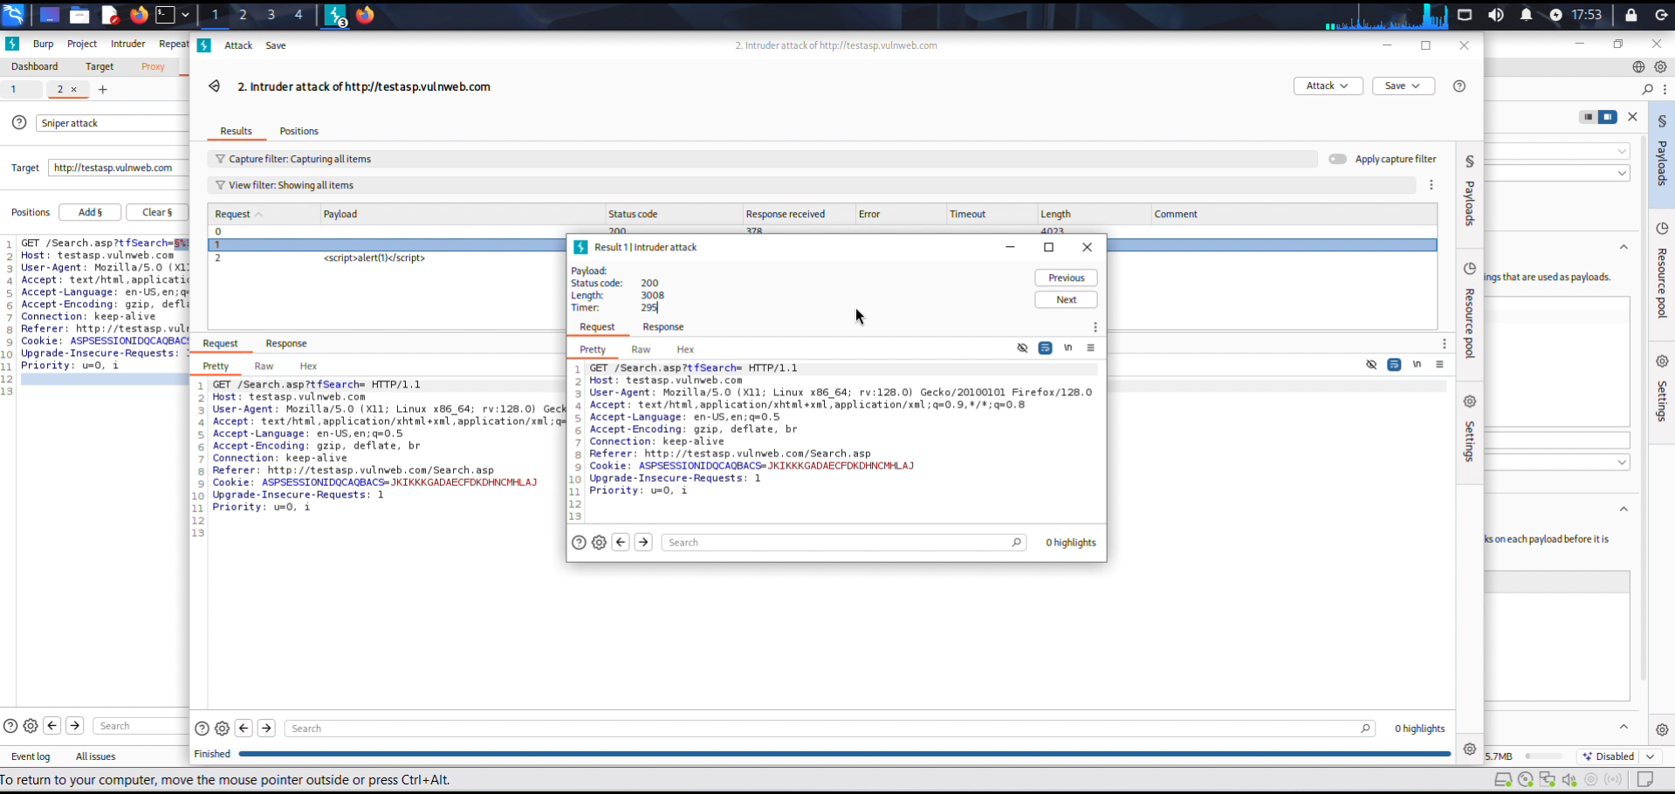

Slide 9
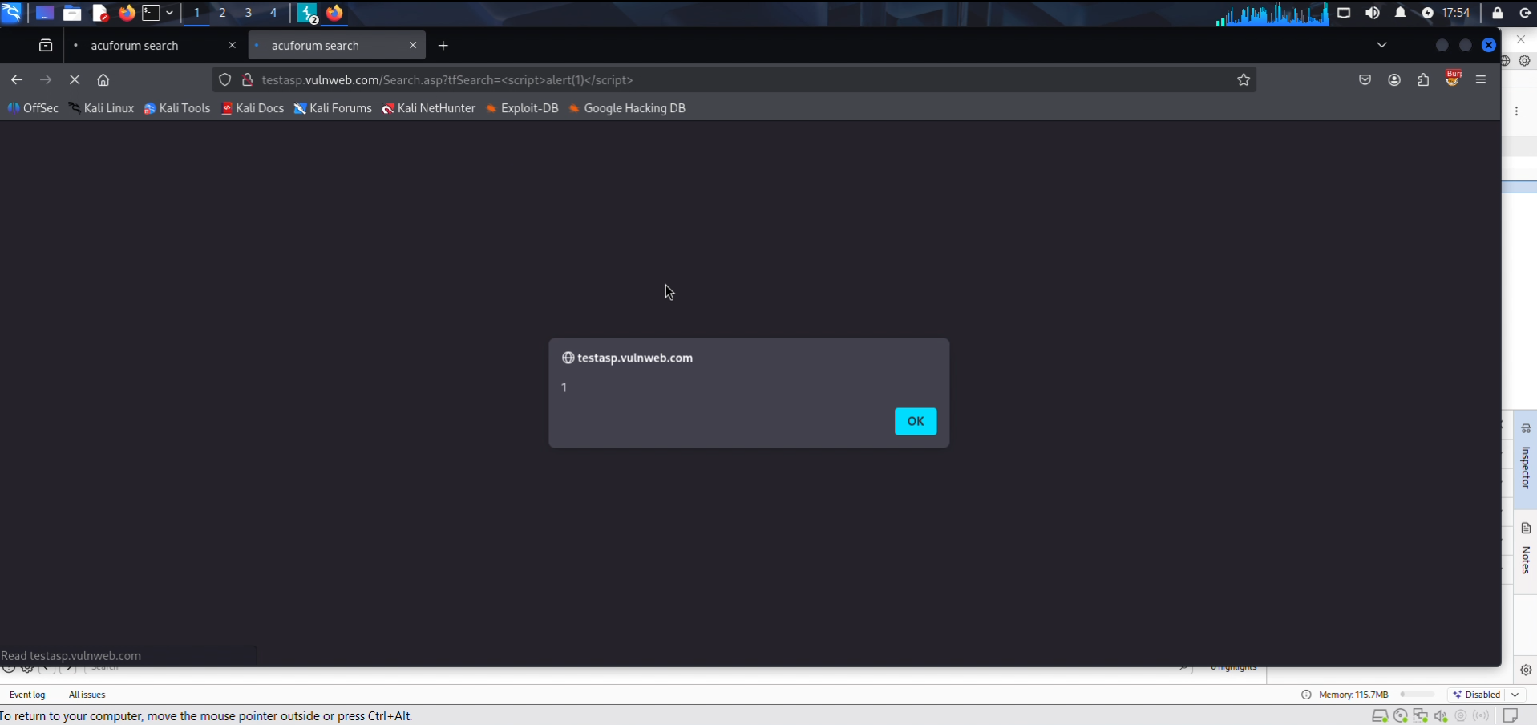

Slide 10
Continuation to the report on Task 2 -
Adding on to this report this will impact your data to be stolen easily by Cross Site Scripting which can be harmful for you company. There are ways to prevent these types of attacks, you can always keep you software up to date. Moreover, you can have a Web Application Firewall to protect you website. Not only this but , you can also enable noscripts on your website.
More screenshots and video regarding this website’s vulnerability
Git Hub : https://github.com/arvindsinghrathore7773/Internship-Studio-ethical-hacking

